Slide 1
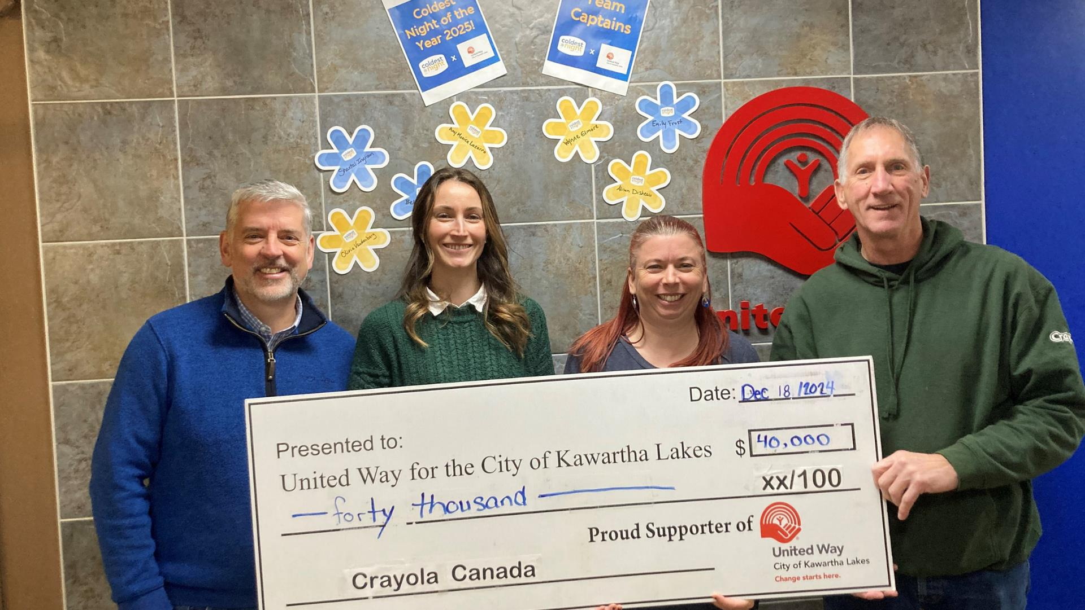
UNITED WAY HALIBURTON KAWARTHA LAKES
2025-2026 CAMPAIGN
Building Community in City of Kawartha Lakes and Haliburton County

Slide 2

New name, same commitment to your community
This summer we changed our name from United Way for the City of Kawartha Lakes to United Way Haliburton Kawartha Lakes.
As an organization that has long provided services and supports in both regions, this change will better reflect both unique communities.
Although we are operating under UWHKL, the full transition will take some time. Donations can now be made out to United Way Haliburton Kawartha Lakes.
During this transition, we are committed to continuing to be a voice for our communities, provide resources and supports, and deliver on our mission to build a strong community and improve lives in Haliburton and Kawartha Lakes.

Slide 3
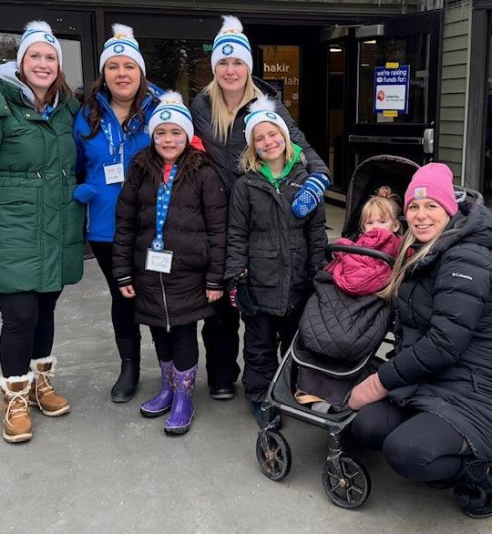
Your United Way
United Way for Haliburton Kawartha Lakes supports agencies and programming in the City of Kawartha Lakes and Haliburton County. All funds raised stay local. Therefore, funds raised in Kawartha Lakes stay in CKL and funds raised in Haliburton County stay in Haliburton County.
None of this is possible without the support of our valued donors. UWHKL needs your support more than ever as we continue to work with our partners to help the community grow and build towards a stronger future. The following pages provide more information about our work, what will be needed going forward and how you can help.

Slide 4

What does United Way HKL do?
United Ways across Canada bring people and organizations together to meet community needs and tackle complex social issues.

Slide 5
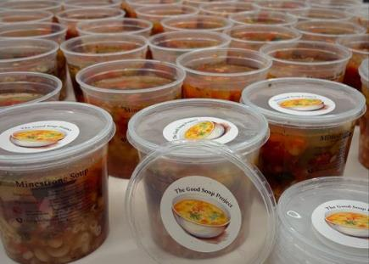
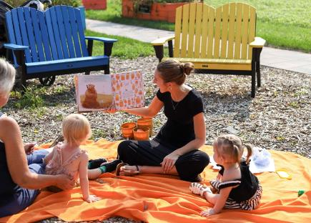
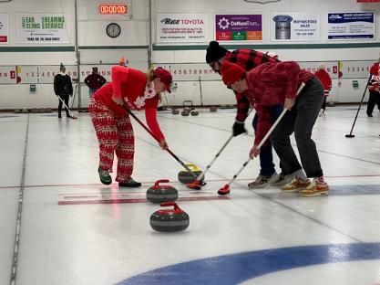
The Three Pillars
United Way’s work focuses on three key strategies that create opportunities for everyone in our communities to live a better life.
From Poverty to Possibility:
All That Kids Can Be
Healthy People, Strong Communities
Giving children and youth the support they need to get a great start in life, do well in school, and reach their full potential.
Helping to meet the basic needs of our community’s most vulnerable people, giving every Canadian the opportunity to realize a better future.
Creating vibrant neighbourhoods, where everyone experiences a sense of belonging and connection to one another.

Slide 6
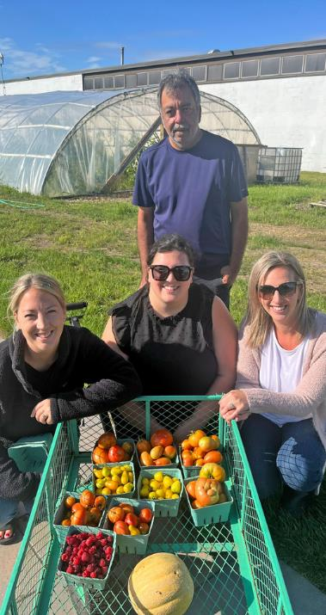
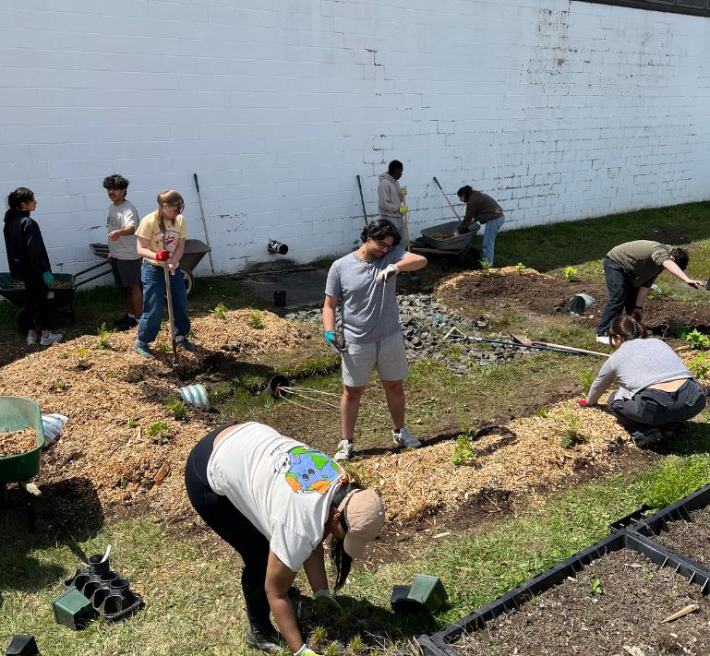

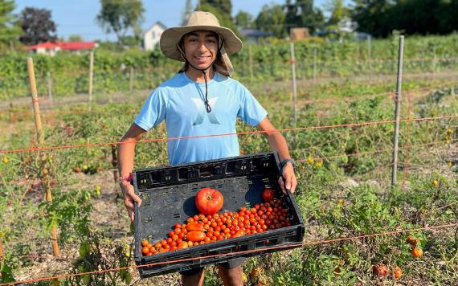
Edwin Binney's Community Farm and Education Centre
Since 2019, Edwin Binney’s Community Farm & Education Centre, UWHKL’s large scale food security project has provided over 88,000 pounds of fresh produce to the clients of ten food banks and twenty social service agencies, including 14,165 pounds in 2024. That is equal to over $41,000 of food in one growing season - the equivalent of 3,603 meals. Although we produced less in 2024 than we did in 2023, we increased our reach and donated to more locations, ensuring that more people in Kawartha Lakes and Haliburton County have access to the fresh produce that they need.
The impact of Edwin Binney’s Community Farm and Education Centre continues to grow in spite of being faced with two years of crop reduction dues to weather events. Programs for children and youth continue to be a central part of the of the farm, with groups attending workshops from schools, summer camps and day cares.
The rising cost of food means that our food security work through Edwin Binney’s Farm and Education Centre is more important than ever. To add to this challenge, we received news in March 2025 that Fleming College would be suspending their Sustainable Agriculture Co-op program. We have taken this challenge as an opportunity to seek out new partnerships and funding sources in the community and beyond. The support we have received from the community who have become farm and farm steering committee volunteers has been wonderful to see. We are always happy to have workplaces join us at the farm. Many hands make light work and it is a great opportunity for team building!

Slide 7
United Way funds vital projects in CKL and Haliburton
  Provided grocery cards to households accessing shelter drop-in services. Drop-In Services support individuals at risk of homelessness or those who have recently left the shelter and need further assistance to stabilize their housing. By providing emergency food resources, this project will help clients allocate more of their financial resources towards rent, thereby preventing homelessness. Ensuring adequate nutrition will not only combat hunger but also support the mental and physical health of clients, empowering them to overcome their current challenges.
  Provided Developmental Relationship Training for Big Brothers Big Sisters Mentors. This specialized training in developmental relationships ensures that youth receive meaningful support in five key areas: expressing care, challenging growth, providing support, sharing power, and expanding possibilities. These elements help young people build confidence, develop resilience, and acquire essential life skills. Mentors will be better prepared to encourage emotional regulation, self-advocacy, and goal setting, helping youth navigate obstacles and make informed decisions about their future.
  Supported a workshop series for women focused on topics such as Literacy and Basic Skills, Harm Reduction, Self Esteem, Self Care, and Healthy Boundaries. The grant provided purchase workshop materials, food, basic need supports and assisted with transportation costs which can be a major barrier for women in rural communities.
During the 2024-2025 Campaign we funded projects that:
  Provided grocery gift cards for job seekers who are struggling to put food on the table while they look for work.
  Created a support space for People with Lived and Living Experience that gave them a space to visit that was theirs, where they could feel like they 'fit in', gained comfort, took part in activities, and exposed them to referrals and built-in social supports in palatable ways.
  Assisted in providing urgent, essential resources to individuals, families or groups at Acutely Elevated Risk to reduce the risk of harmful incidents occurring. Interventions like transportation, temporary shelter, moving belongings, accessing food, assisting in getting clients to treatment programs or getting needed treatments such as medications, and connecting those in need to appropriate services.
  Provided for a counsellor to be trained in Eye Movement Desensitization and Reprocessing Therapy. This training allowed this therapy to be offered in City of Kawartha Lakes, removing the need to travel to Peterborough for treatment.

Slide 8
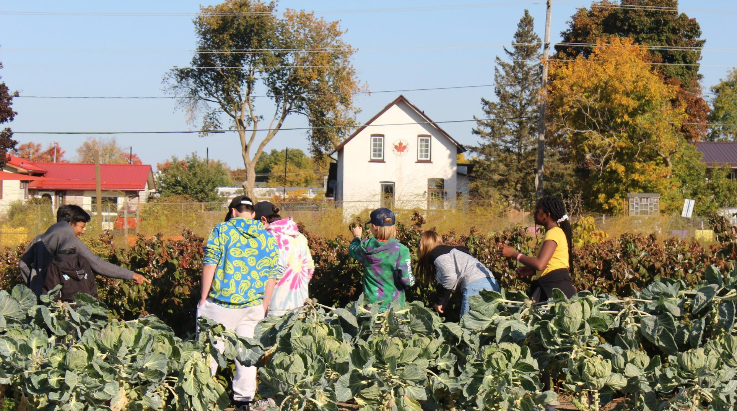
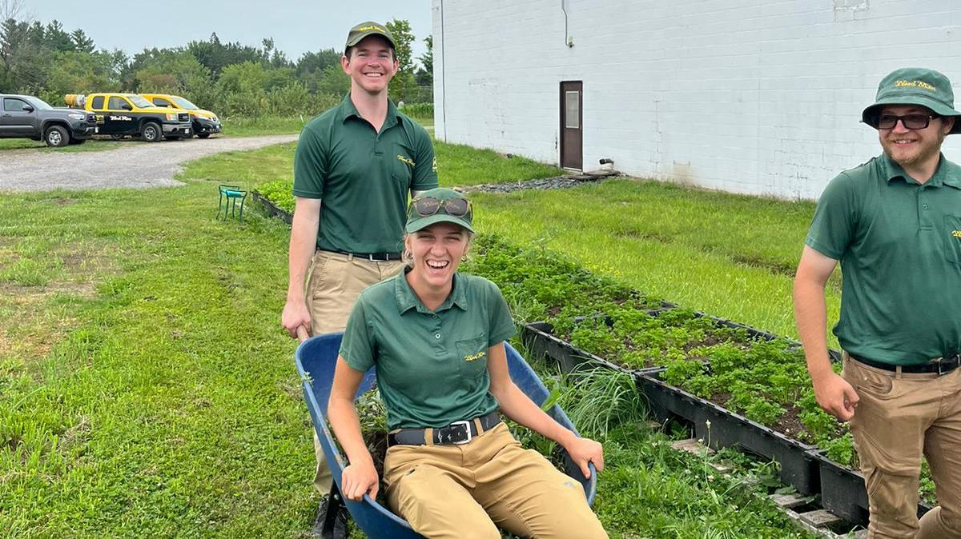
On site workshops, tours and team building opportunities are available at the farm. Come out and volunteer with your colleagues!
Contact E at gardencoordinator@hkl.unitedway.ca
for more information.
"Best field trip ever!"
2023 CKL Summer Camp participant

Slide 9

Leadership Giving:
Your Leadership changes lives. Become a Leadership Donor today!
Leadership donors have the power to be instruments of change. They inspire others and create hope for tomorrow.
With a donation of $1,200 or more, our Leadership level donors are ready to drive change, willing to set a powerful example and become part of the solution to our community’s complex social issues. Local Leaders are passionate about leaving their mark on City of Kawartha Lakes and Haliburton County by creating lasting change.

Slide 10
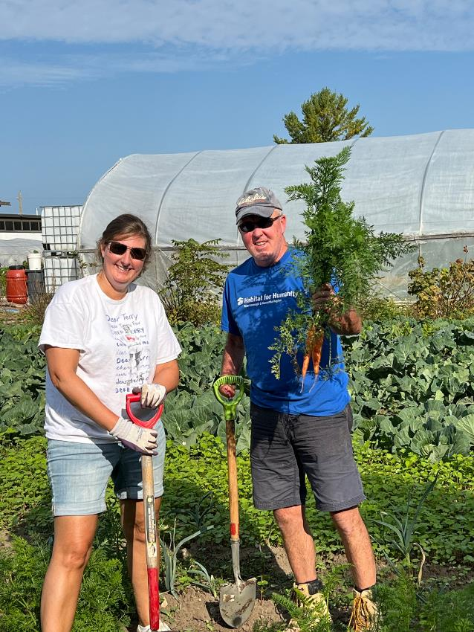
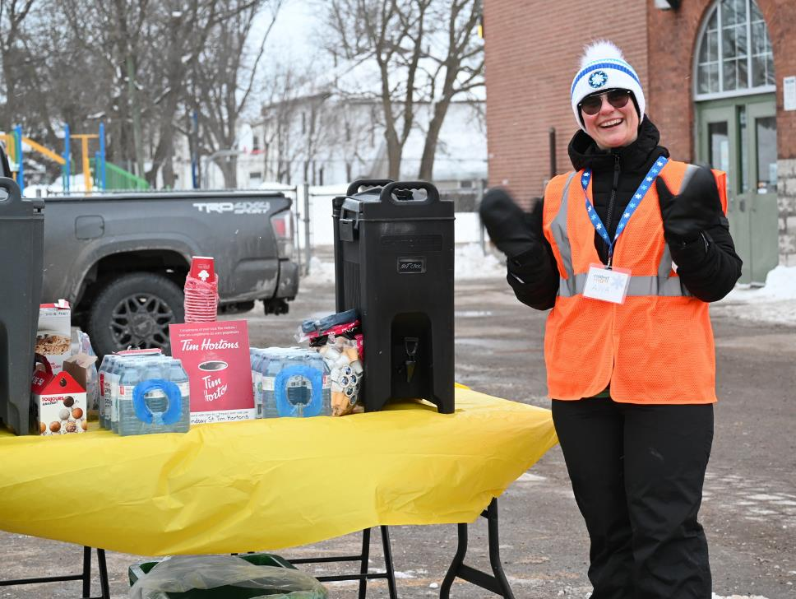
HOW CAN I HELP?

Slide 11
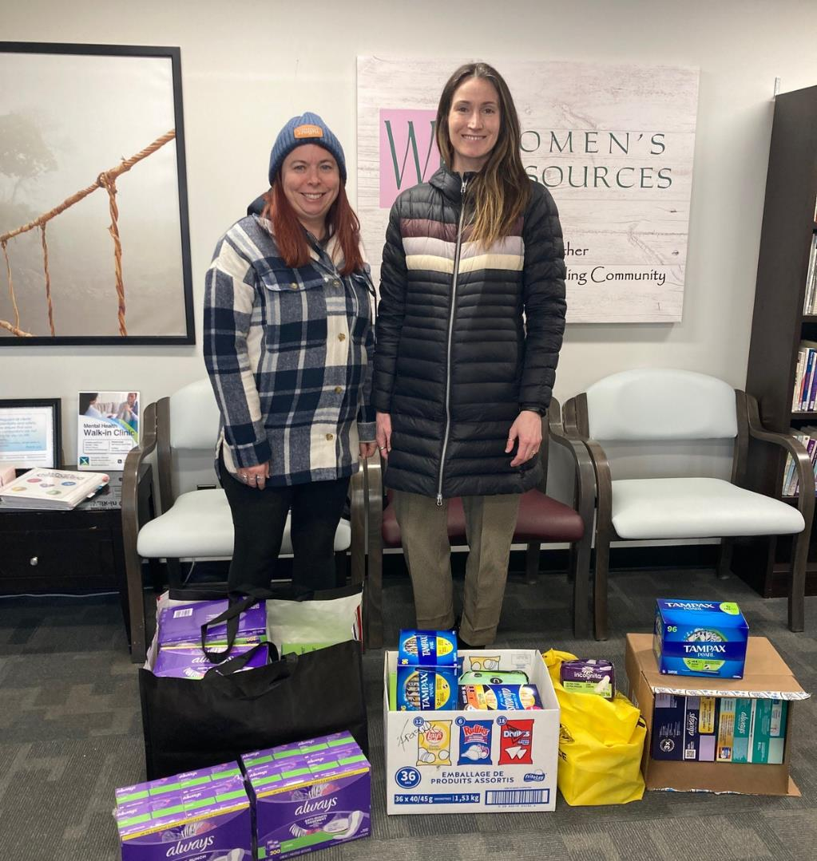
There are many ways to support your United Way!
  Corporations can consider matching public and/or employee donations.
  Donate through payroll deduction at work!
  If you can, become a Leader of the Way donor!
  Make a one-time donation at your workplace!
  Donate online through our website! hkl.unitedway.ca/donate-now/
  Create or participate in special events at work or join us at one of our special events!
  Volunteer at Edwin Binney's Community Farm & Education Centre or a United Way Event!
  Encourage a friend or co-worker to donate to United Way!
  Participate in activities such as Period Promise
  Your business can sponsor a UWHKL event or project (ask us for opportunities and ideas).

Slide 12
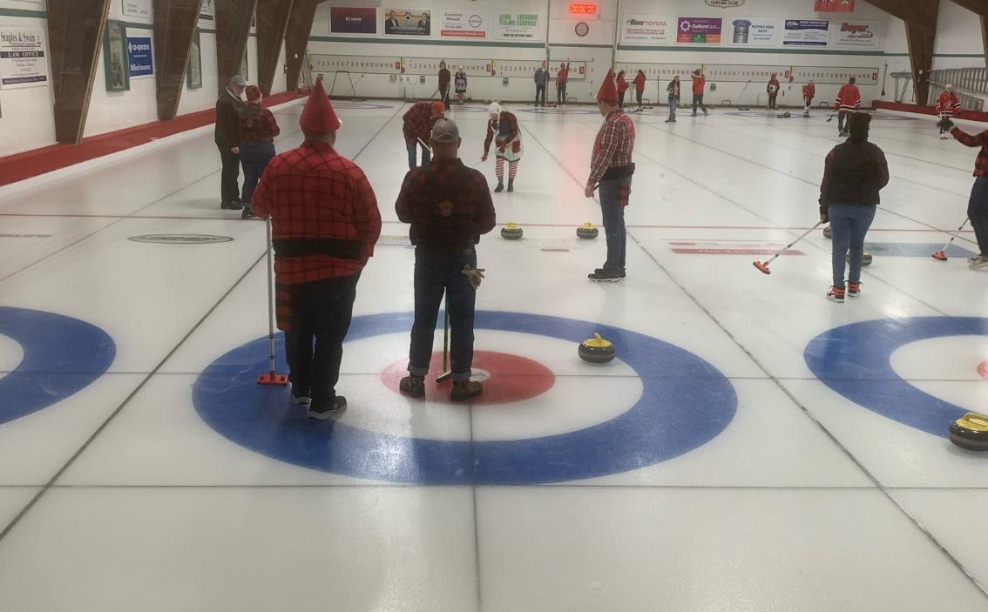
Special event ideas
  Trivia
  Fun run or walk
  Video game sport tournament
  Bingo!
  Get a team together for the Nexicom United Way Funspiel - costumes encouraged!
  Get a staff team together for Coldest Night of the Year.
  And whatever your imagination can come up with. Have fun with your fundraising!

Slide 13


Follow us on Social Media
Facebook: @UWHKL
X: @UnitedWayHKL
Instagram: @unitedwayhkl
YouTube: @UWHKL & @EdwinBinneysCommunityFarm

Slide 14
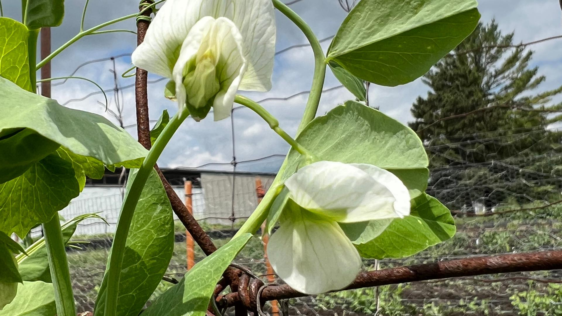
Thank you!
Questions? Contact Shantal Ingram,
Co-Executive Director at shantal@hkl.unitedway.ca
We would be happy to visit your workplace to share more about the work that we do.

