Slide 1
UNITED WAY FOR THE CITY OF KAWARTHA LAKES
2024-2025 CAMPAIGN
Building Community in City of Kawartha Lakes and Haliburton County

Slide 2
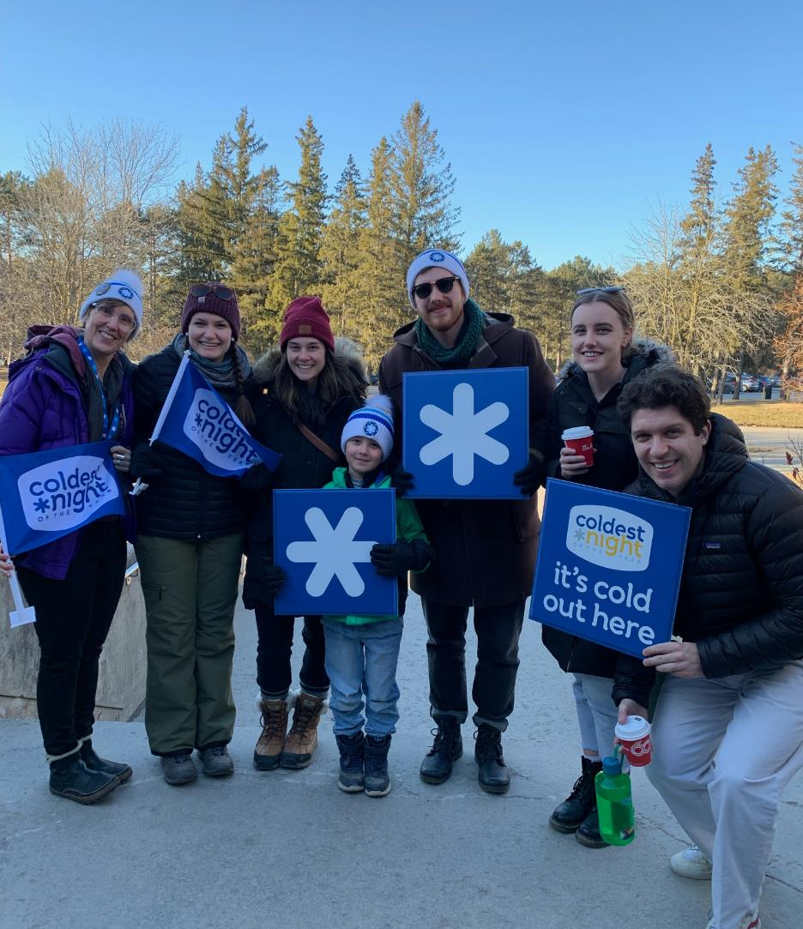
Your United Way
United Way for the City of Kawartha Lakes supports agencies and programming in the City of Kawartha Lakes and Haliburton County. All funds raised stay local. Therefore, funds raised in City of Kawartha Lakes stay in CKL and funds raised in Haliburton County stay in Haliburton County.
None of this is possible without the support of our valued donors. UWCKL needs your support more than ever as we continue to work with our partners to help the community grow and build towards a stronger future. The following pages provide more information about our work, what will be needed going forward and how you can help.

Slide 3
What does United Way CKL do?
United Ways across Canada bring people and organizations together to meet community needs and tackle complex social issues.

Slide 4
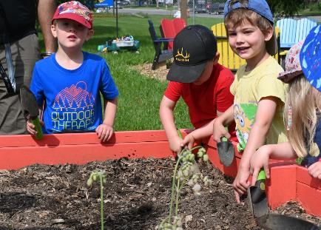
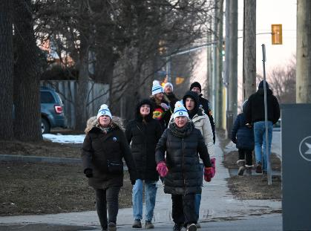
The Three Pillars
United Way’s work focuses on three key strategies that create opportunities for everyone in our communities to live a better life.
From Poverty to Possibility:
All That Kids Can Be
Healthy People, Strong Communities
Giving children and youth the support they need to get a great start in life, do well in school, and reach their full potential.
Helping to meet the basic needs of our community’s most vulnerable people, giving every Canadian the opportunity to realize a better future.
Creating vibrant neighbourhoods, where everyone experiences a sense of belonging and connection to one another.

Slide 5
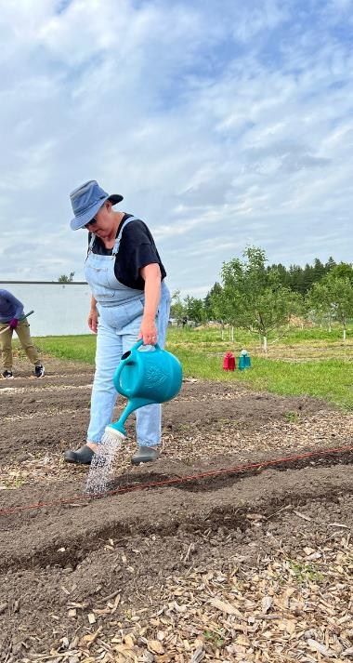
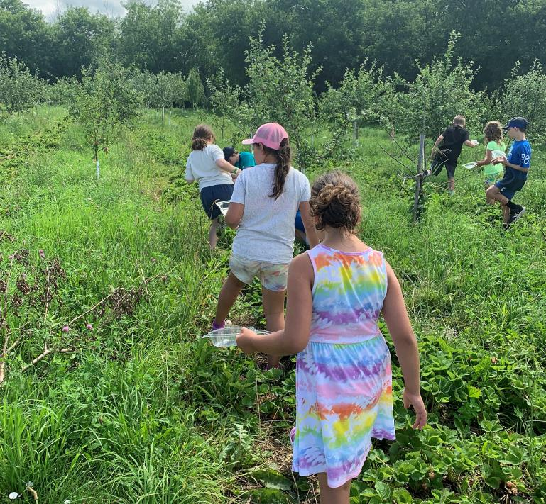
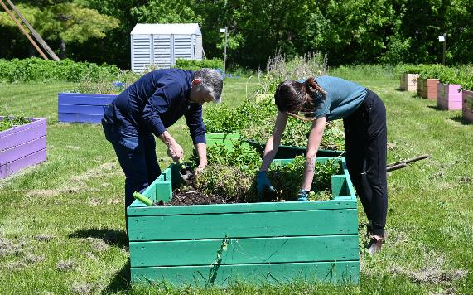
Edwin Binney's Community Farm and Education Centre
Since 2019, Edwin Binney’s Community Farm & Education Centre, UWCKL’s large scale food security project has provided over 75,000 pounds of fresh produce to the clients of ten food banks and twenty social service agencies, including 18,366 pounds in 2023. That is equal to over $52,000 of food in one growing season.
Although weather patterns dictated a later start to planting this year, we are growing abundantly and finding new efficiencies all the time. Our volunteers and farm staff care for the planting, harvesting, and water maintenance, while our Farm Coordinator plans and delivers workshops, educational tours, and corporate volunteer groups.
Growing food to support folks experiencing hunger is a critical piece of what we do. But it is not the only thing we do at the farm. We offer a variety of food literacy and eco-education programming including workshops for school field trips, Kawartha Lakes Summer Camps, Pop-Up Storytime with the Library, Sustainable Agriculture Camp with Pinnauq and volunteer sessions suitable for folks of all ages and abilities.
A couple years ago we introduced our farm stand which we run on Tuesdays from 10am until 2pm outside the UWCKL office. We offer our produce at variable pricing to fit any and all budgets.
There is something for everyone; whether you are accessing food supports, learning about local food and community development, or helping us ensure we can grow productively to support our neighbours!

Slide 6
United Way funds vital projects in CKL and Haliburton
During the 2023-2024 Campaign we funded projects that:
Provided academic and non-academic support to at-risk youth and connected them to resources to ensure basic needs were met.
Stocked 2 little pantries with food and hygiene products.
Provided free nutritious meals to food insecure individuals, ensuring that a service gap was prevented.
Provided training for instructors and expanded the volunteer pool for a therapeutic horse riding program for individuals with a variety of disabilities and injuries.
Provided grocery gift cards for job seekers who are struggling to put food on the table while they look for work.
Provided for a Peer Worker and a Peer Education & Support Specialist to be present for bi-monthly social gatherings in a small rural community, offering counseling, training, mentoring and outreach.

Slide 7
On site workshops, tours and team building opportunities are available at the farm. Come out and volunteer with your colleagues!
"Best field trip ever!"
2023 CKL Summer Camp participant
Contact E at gardencoordinator@ckl.unitedway.ca
for more information.

Slide 8
Leaders of the Way - Why leadership giving is important.
Set a powerful message in your community. As a Leader, you'll become part of an unstoppable force for change. Your support will drive social change and make a lasting impact for those most vulnerable in the City of Kawartha Lakes and Haliburton. Donors like you power our work in the community addressing food insecurity and other urgent needs.
Levels:
Level 1: Bronze $1,200 - $1,499
Level 2: Silver $1,500 – $4,999
Level 3: Gold $5,000+
Visit: https://ckl-unitedway.ca/leadership-giving-2/ to learn more about leadership giving.

Slide 9
HOW CAN I HELP?

Slide 10
There are many ways to support your United Way!
Corporations can consider matching public and/or employee donations.
Donate through payroll deduction at work!
If you can, become a Leader of the Way donor!
Make a one-time donation at your workplace!
Donate online through our website! ckl-unitedway.ca
Create or participate in special events at work or join us at one of our special events!
Volunteer at Edwin Binney's Community Farm & Education Centre or a United Way Event!
Encourage a friend or co-worker to donate to United Way!
Your business can sponsor a UWCKL event or project (ask us for opportunities and ideas).

Slide 11
Special event ideas
Trivia
Fun run or walk
Video game sport tournament
Bingo!
Participate in Novemburger as a staff with lunch from a participating restaurant. Yum!!
Get a staff team together for Coldest Night of the Year.
And whatever your imagination can come up with. Have fun with your fundraising!

Slide 12
Follow us on Social Media
Facebook: @UWCKL
Twitter: @UnitedWayCKL
Instagram: @unitedwayckl
YouTube: @UWCKL & @EdwinBinneysCommunityFarm

Slide 13
Thank you!
Questions? Contact Shantal Ingram,
Co-Executive Director at shantal@ckl.unitedway.ca
We would be happy to visit your workplace to share more about the work that we do.

