Slide 1
UNITED WAY FOR THE CITY OF KAWARTHA LAKES
2023-2024 CAMPAIGN
Building Community in City of Kawartha Lakes and Haliburton County

Slide 2
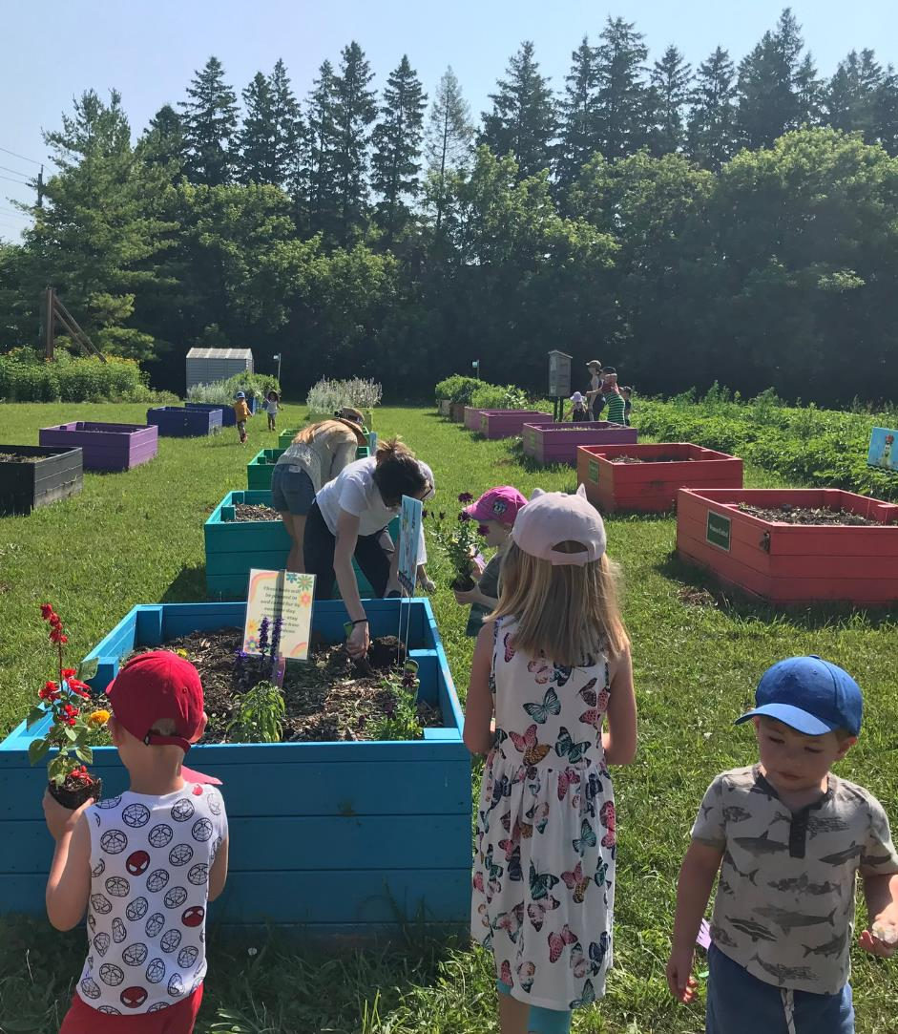
Your United Way
United Way for the City of Kawartha Lakes supports agencies and programming in the City of Kawartha Lakes and Haliburton County. All funds raised stay local. Therefore, funds raised in City of Kawartha Lakes stay in CKL and funds raised in Haliburton County stay in Haliburton County.
None of this is possible without the support of our valued donors. UWCKL needs your support more than ever as we continue to work with our partners to help the community grow and build towards a stronger future. The following pages provide more information about our work, what will be needed going forward and how you can help.

Slide 3
What does United Way CKL do?
United Ways across Canada bring people and organizations together to meet community needs and tackle complex social issues.

Slide 4
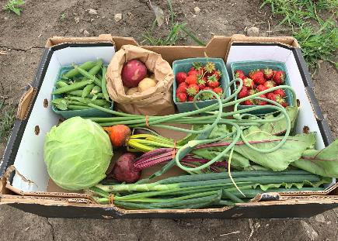
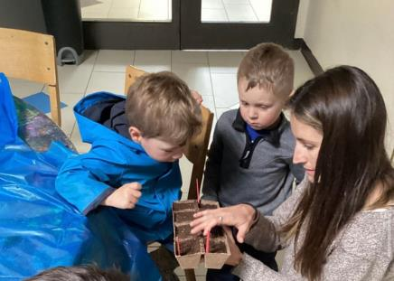
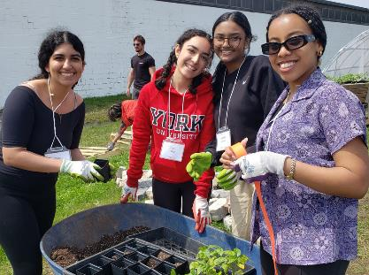
The Three Pillars
United Way’s work focuses on three key strategies that create opportunities for everyone in our communities to live a better life.
From Poverty to Possibility:
All That Kids Can Be
Healthy People, Strong Communities
Giving children and youth the support they need to get a great start in life, do well in school, and reach their full potential.
Helping to meet the basic needs of our community’s most vulnerable people, giving every Canadian the opportunity to realize a better future.
Creating vibrant neighbourhoods, where everyone experiences a sense of belonging and connection to one another.

Slide 5
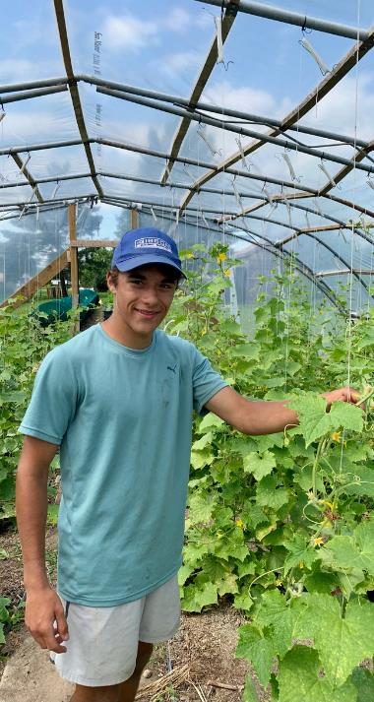
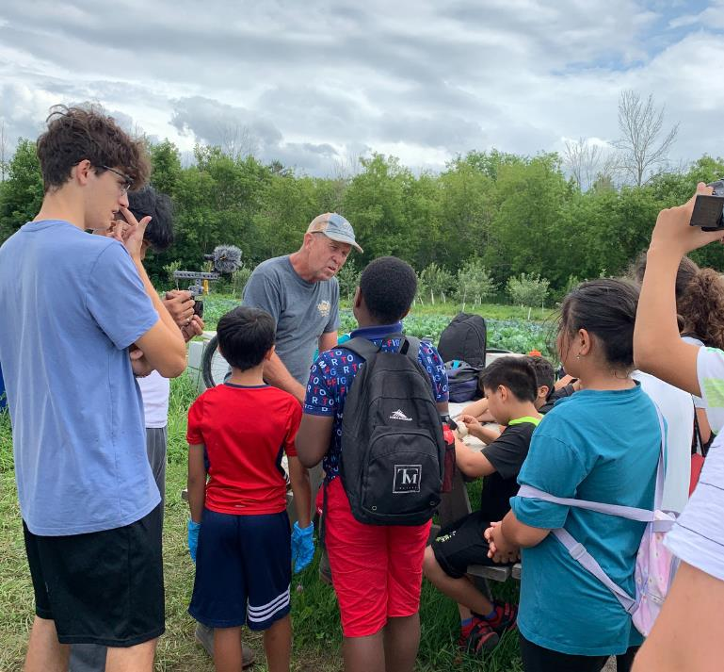
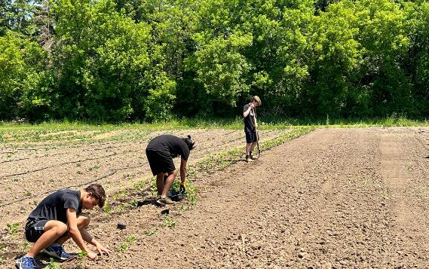
Edwin Binney's Community Farm and Education Centre
Since 2019, Edwin Binney’s Community Farm & Education Centre, UWCKL’s large scale food security project has provided over 60,000 pounds of fresh produce to the clients of ten food banks and twenty social service agencies, including 21,683 pounds in 2022.
You may notice that the name has changed from Edwin Binney's Community Garden. Why did we do that? Simply because the term ‘garden’ no longer properly explains what this project has evolved into. It truly is a small farm, covering almost all of the 4 acres of available land.
We have harvested over 14,000 pounds so far. We are especially happy about that total this year, as we sustained some damage during the August 3rd hail storm. We lost 20 trees from our fruit orchard and sustained damage to our corn, cabbage, melon, squash, tomatoes and some apples on the surviving trees. We replanted what we could, but we will see a reduction in some of what we are able to harvest as a result of the storm.
We are excited about the variety of programming we have had at the farm this year. We've hosted school programs, Kawartha Lakes Summer Camps, groups from BGC Kawarthas, a Pop-Up Storytime with the Library, an Art Gallery art class and groups from the Institute for Studies in Global Prosperity for learning and volunteer sessions.
Never a dull moment at the farm!

Slide 6
United Way funds vital projects in CKL and Haliburton
In 2022, through our Community Capacity and Matching Collaborative Grants, we funded projects that:
Improved access to transportation by providing shelter residents with bicycles that they could borrow in order to attend job interviews, medical appointments or connect with friends.
Provided grocery gift cards for job seekers who are struggling to put food on the table while they look for work.
Helped residents in need access food and hygiene products through a little pantry.
Connected families to the services and supports that will address their specific needs.
Connected rural seniors and youth through intergenerational programming to work together and express their creativity.
Connected organizations and service providers with people with lived experience in order learn from their experiences and through this improve program and service delivery.

Slide 7
On site workshops, tours and team building opportunities are available at the farm. Come out and volunteer with your colleagues!
"Best field trip ever!"
2023 CKL Summer Camp participant
Contact E at gardencoordinator@ckl.unitedway.ca
for more information.

Slide 8
2023-2024 Campaign Chair
Jeff Tompkins
Campaign Chair
We are excited to have Jeff back for another year as campaign chair. Read below for his bio.
My name is Jeff Tompkins, and I am proud to stay on this year with the United Way as their Campaign Chair for the City of Kawartha Lakes and Haliburton County. Born and raised here, I left and went to SSFC for Business. I moved to Toronto for work and back to the area to start a family. Now, both my daughters have moved to Nova Scotia for university. I got remarried to my wonderful wife, Lynn, just over 3 years ago. Five and a half years ago I started my first company, RJT Office Solutions. Later that year I started a pop-up store for Christmas called Wall It Wall Art. I have since opened a permanent location for both the stores in the Cambridge Mall in beautiful downtown Lindsay. I am an active member of the 100 Men of Kawartha Lakes.
I am excited to stay on with the United Way this year to help grow the fundraising campaign. I am looking forward to the coming year and the support that we will get from the community at large. I look forward to meeting members of the community at our fundraising opportunities that we will be having this year!

Slide 9
Leaders of the Way - Why leadership giving is important.
Set a powerful message in your community. As a Leader, you'll become part of an unstoppable force for change. Your support will drive social change and make a lasting impact for those most vulnerable in the City of Kawartha Lakes and Haliburton. Donors like you power our work in the community addressing food insecurity and other urgent needs in your community.
Levels:
Level 1: Bronze $1,200 - $1,499
Level 2: Silver $1,500 – $4,999
Level 3: Gold $5,000+
Visit: www.ckl.... to learn more about leadership giving.

Slide 10
HOW CAN I HELP?

Slide 11
There are many ways to support your United Way!
Corporations can consider matching public and/or employee donations.
Donate through payroll deduction at work!
If you can, become a Leader of the Way donor!
Make a one-time donation at your workplace!
Donate online through our website! ckl-unitedway.ca
Create or participate in special events at work or join us at one of our special events!
Volunteer at Edwin Binney's Community Farm & Education Centre!
Encourage a friend or co-worker to donate to United Way!
Your business can sponsor a UWCKL event or project (ask us for opportunities and ideas).

Slide 12
Special event ideas
Trivia
No Gala Gala
Run/walk/roll
Video game sport tournament
Bingo!
And whatever your imagination can come up with. Have fun with your fundraising!

Slide 13
Follow us on Social Media
Facebook: @UWCKL
Twitter: @UnitedWayCKL
Instagram: @unitedwayckl

Slide 14
Thank you!
Questions? Contact Shantal Ingram,
Co-Executive Director at shantal@ckl.unitedway.ca
We would be happy to visit your workplace to share more about the work that we do.

